Slide 1
Matrix-chain Multiplication
We are given a sequence (chain) A₁, A₂, . . ., A_{n} of n matrices to be multiplied
We wish to compute the product
A₁x A₂ x …… x A_{n}
Matrix multiplication has associative property:
(AxB)xC=Ax(BxC)

Slide 2
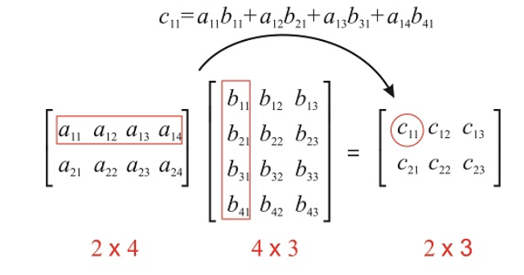


What is Matrix Multiplication?
Number of multiplications: 2x4x3

Slide 3
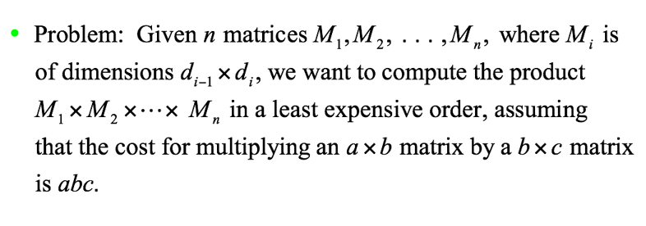
Formal Problem Definition for Matrix-chain Multiplication

Slide 4
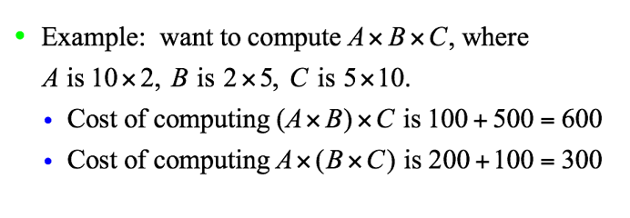
Example

Slide 5
Brute Force Approach for Matrix Multiplication
Consider all possible multiplication cases and choose the one with minimum number of operations
Example of two possibilities:
A₄
A₃
A₁
A₂
A₃
A₄
A₁
A₂
(A₁ x A₂) x (A₃ x A₄ )
((A₁ x A₂) x A₃) x A₄

Slide 6
Does the Optimal Sub-Structure for Matrix Multiplication Hold?
To use DP to solve the problem, first we should prove that it follows the principle of optimality
In this case the optimal substructure is defined as follows:
The optimal order of multiplying n matrices includes the optimal order for multiplying any subset of the n matrices.
Example: A₁(A₂ (A₃ A₄)) is optimal, if the number of operations on A₂ (A₃ A₄) is optimal!
This feature trivially holds, so we can use DP

Slide 7
Dynamic Programming for Matrix Multiplication
A₁ x A₂ x A₃
2 x 3
3 x 4
4 x 5
d₀ x d₁
d₁ x d₂
d₂ x d₃
C[i,j]={C[i,k]+C[k+1,j]+d_{i-1} x d_{k} x d_{j}}
( A₁ x A₂ ) x A₃
A₁ x ( A₂ x A₃ )
2 x 3
3 x 4
C[3,3]=0
C[1,1]=0
3 x 4
4 x 5
Cost=C[1,2]= 2 x 3 x 4 = 24
Cost=C[2,3]= 3 x 4 x 5 =60
C[1,3]=C[1,2]+C[3,3]+2 x 4 x 5= 64
C[1,3]=C[1,1]+C[2,3]+2 x 3 x 5= 90
d₀ x d₂ x d₃
d₀ x d₁ x d₃
i
k
j
i
k
j
d _{j}
d _{i-1}
d _{j}
k+1
d _{i-1}
k+1
d_{k}
d_{k}

Slide 8
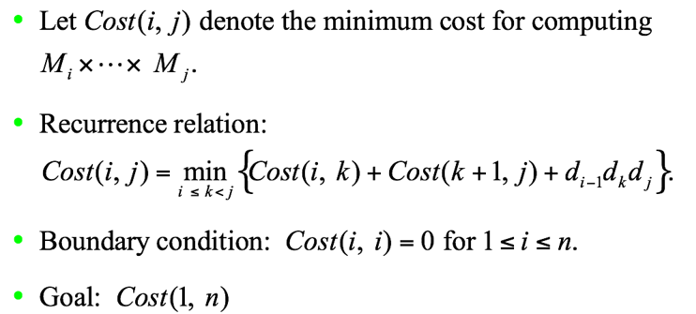
Dynamic Programming Solution

Slide 9
Minimum Multiplications Algorithm
int MinMult(int n, const int d[], index K[][]){
//n: number of matrices; d: array of integers; K: array of K-values
index i, j, k, diagonal;
int C[1..n][1..n];
for( i = 1; i ≤ n; i++)
C[i][i]=0;
for(diagonal=1; diagonal ≤ n – 1; diagonal++) //diagonal is above the main diagonal
for( i= 1; i ≤ n-diagonal; i++){
j= i + diagonal;
C[i][j] = min of (i ≤ k < j){C[i][k]+C[k+1][j]+ d[i-1]*d[k]*d[j]};
K[i][j]=a value of K that gave the minimum
}
return C[1][n]; }
Time complexity is O(n³)
Space complexity is O(n²)

